Slide 1

ML.NET
Bringing ML to .NET Developers
Presented by: Markus Weimer
Markus.Weimer@Microsoft.com
https://dot.net/ml

Slide 2

Brought to you by (amongst others)
Zeeshan Ahmed (Microsoft) zeahmed@microsoft.com, Saeed Amizadeh (Microsoft) <saamizad@microsoft.com>, Mikhail Bilenko (Yandex) <mbilenko@yandex-team.ru>, Rogan Carr (Microsoft) <rocarr@microsoft.com>, Wei-Sheng Chin (Microsoft) <WeiSheng.Chin@microsoft.com>, Yael Dekel (Microsoft) <yaeld@microsoft.com>, Xavier Dupre (Microsoft) <xadupre@microsoft.com>, Vadim Eksarevskiy (Microsoft) <Vadim.Eksarevskiy@microsoft.com>, Senja Filipi (Microsoft) <sefilipi@microsoft.com>, Tom Finley (Microsoft) <tfinley@microsoft.com>, Abhishek Goswami (Microsoft) <agoswami@microsoft.com>, Monte Hoover (Microsoft) <Monte.Hoover@microsoft.com>, Scott Inglis (Microsoft) <singlis@microsoft.com>, Matteo Interlandi (Microsoft) <mainterl@microsoft.com>, Najeeb Kazmi (Microsoft) <nakazmi@microsoft.com>, Gleb Krivosheev (Microsoft) <gleb.krivosheev@skype.net>, Pete Luferenko (Microsoft) <Pete.Luferenko@microsoft.com>, Ivan Matantsev (Microsoft) <ivmatan@microsoft.com>, Sergiy Matusevych (Microsoft) <sergiym@microsoft.com>, Shahab Moradi (Microsoft) <shmoradi@microsoft.com>, Gani Nazirov (Microsoft) <ganaziro@microsoft.com>, Justin Ormont (Microsoft) <Justin.Ormont@microsoft.com>, Gal Oshri (Microsoft) <gaoshri@microsoft.com>, Artidoro Pagnoni (Microsoft) <Artidoro.Pagnoni@microsoft.com>, Jignesh Parmar (Microsoft) <jignparm@microsoft.com>, Prabhat Roy (Microsoft) <Prabhat.Roy@microsoft.com>, Zeeshan Siddiqui (Microsoft) <mzs@microsoft.com>, Markus Weimer (Microsoft) <mweimer@microsoft.com>, Shauheen Zahirazami (Microsoft) <shzahira@microsoft.com>, Yiwen Zhu (Microsoft) <zhu.yiwen@microsoft.com>, …

Slide 3
An open source and cross-platform machine learning framework
Machine Learning made for .NET Developers
Covers many developer scenarios
Available in C#, F# and VB.NET
Open source and cross-platform
Windows, Linux, Mac
X64, x86 (some), ARM (some)
Proven and extensible
Development started ~10 years ago
Received contribution (and scrutiny) from all of MS

Slide 4

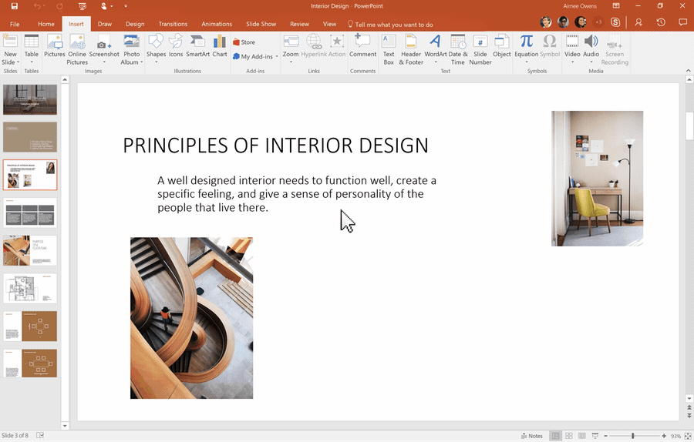
Example Use Case
PowerPoint Designer with ML.NET

Slide 5





ML.NET is used in many products
Many MS products use TLC ML.NET.
You have likely used ML.NET today ☺
Why is that?
Many products are written in (ASP).NET
Using ML.NET is just like using any other .NET API

Slide 6
Using a model is just like using code
Resource shipped with the app.
Standard software dependency
var model = mlContext.Model.Load(“mymodel.zip”);
var predFunc = trainedModel
.MakePredictionFunction<T_IN, T_OUT>(mlContext);
var result = predFunc.Predict(x);
Training: Think sklearn, but with a statically typed language

Slide 7


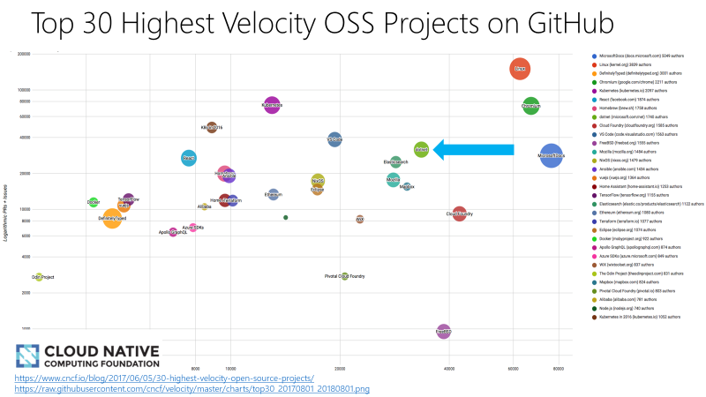
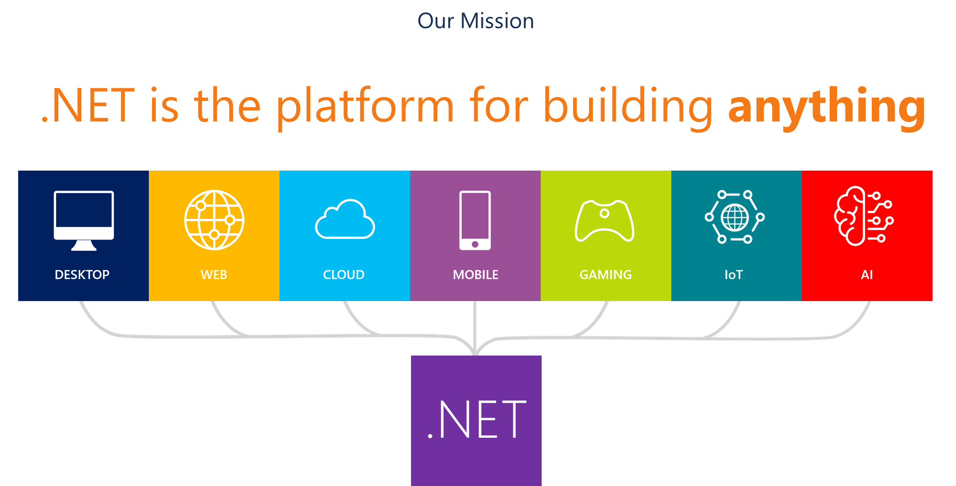
About .NET
.NET
.NET has cool stuff ML people care about
C#: Like Java, but from the future
F#: Like Python, but with static types and multithreading
Almost-free calls into native code
.NET is OSS and cross platform
Windows (surprise!), Linux, macOS
Phones via Xamarin: Android, iOS
Interesting HW: Xbox, IoT devices, …
Lots of developers build important stuff in .NET
4M active; 450k added each month
15% growth MoM in https://github.com/dotnet
Half the top-10k websites are built in .NET

Slide 8
ML.NET is fast & good
Core infrastructure: IDataView
Carefully designed to avoid memory allocations
Only required data is lazily materialized
Carefully tuned defaults
Many ML tasks are more alike than we’d like to admit ☺
GBDT Experiments done on Criteo, using default parameters

Slide 9
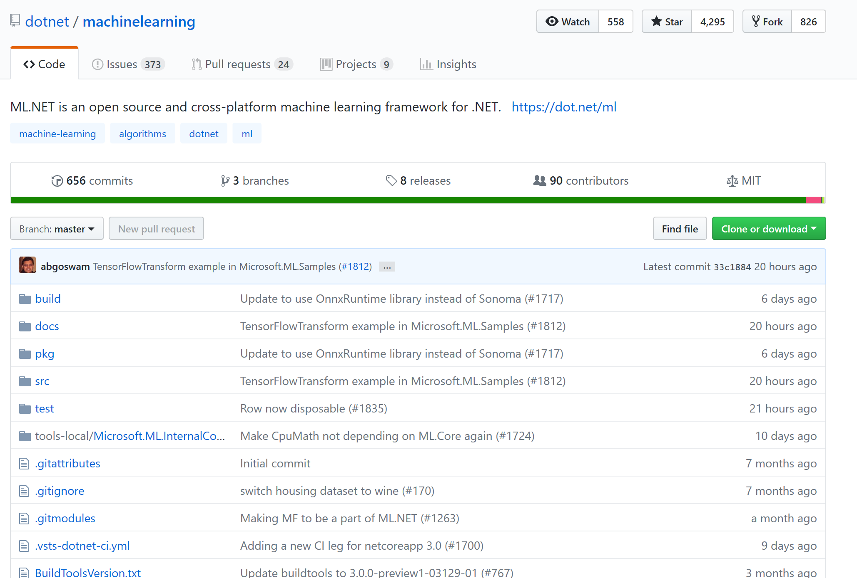
ML.NET’s journey to OSS
Developed for almost a decade as an internal tool
Open Sourced in May 2018 (at //build)
MIT License, .NET Foundation
Monthly releases ever since; 0.8 on Tuesday
Please check it out, and leave feedback

Slide 10

Thanks for your time! Let’s stay in touch!
ML.NET is ML for .NET
https://dot.net/ml
https://github.com/dotnet/machinelearning
You can reach me at:
Markus.Weimer@Microsoft.com
@MarkusWeimer
Poster here today
Poster tomorrow in the MLOSS workshop.
Of course, we are hiring (interns as well)

